Slide 1
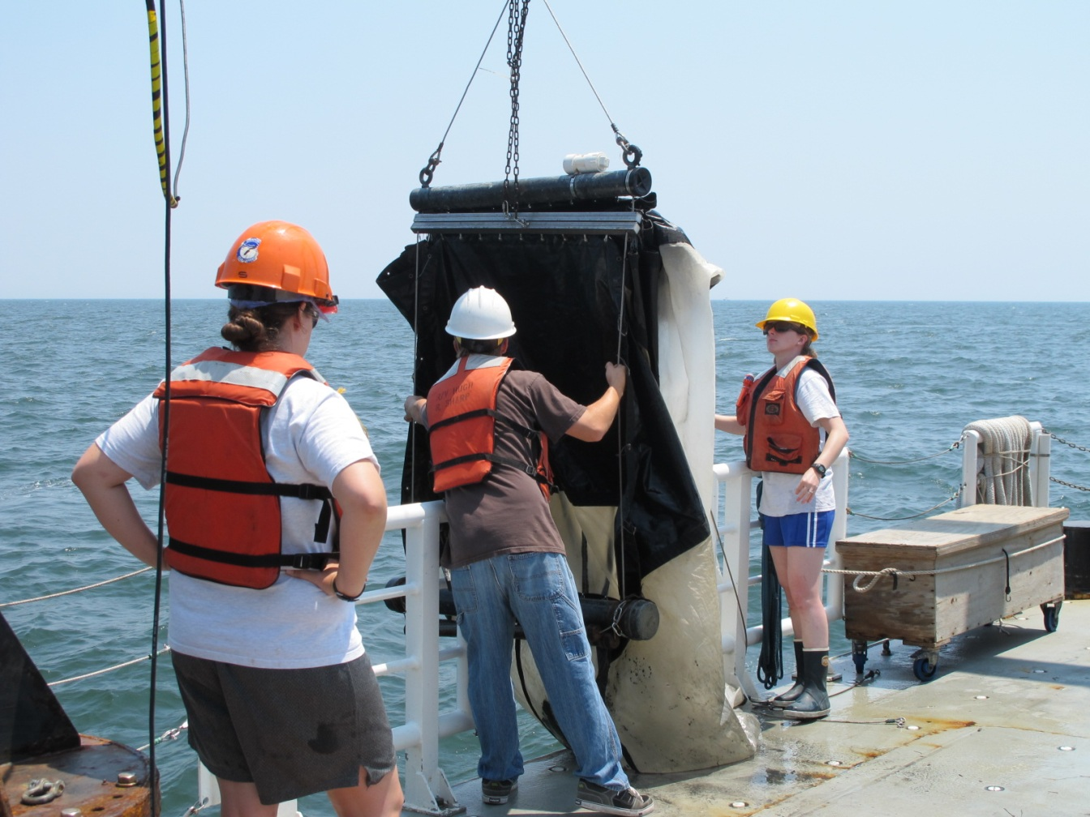
Mortality by Gelatinous Zooplankton
Goals:
To estimate predation rates of Mnemiopsis leidyi Chrysaora quinquecirrha from depth-specific
Tucker Trawls

Slide 2
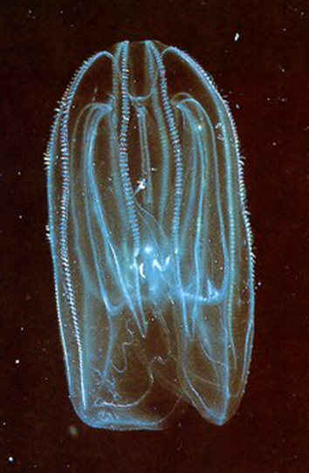
Predation Rate Calculations
Estimate individual ingestion rates for Mnemiopsis
using Purcell et al. 2001:
C_{Mnem} =11.22X ^{0.5413}
where X is ctenophore wet weight (g) and
C_{Mnem} is the volume of A. tonsa cleared
(liters cleared ctenophore⁻¹ d⁻¹)
2) Estimate population clearance rate (liters cleared m⁻³ d⁻¹) by multiplying C_{mnem} by ctenophore density (no. m⁻³)

Slide 3
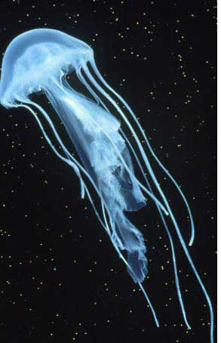
Predation Rate Calculations
Estimate individual sea nettle ingestion rate using Purcell (1992) equation:
logY =0.85log X1 +1.43log X 2 +3.96log X3 −6.43,
where Y is copepods eaten (no. medusa⁻¹ d⁻¹),
X1 is copepod density (no. l⁻¹),
X2 is sea nettle bell (mm),
X3 is temperature (°C)
2) Convert to population ingestion rate (no. copes eaten m⁻³ d⁻¹) by multiplying by the sea nettle density (no. m⁻³).

Slide 4
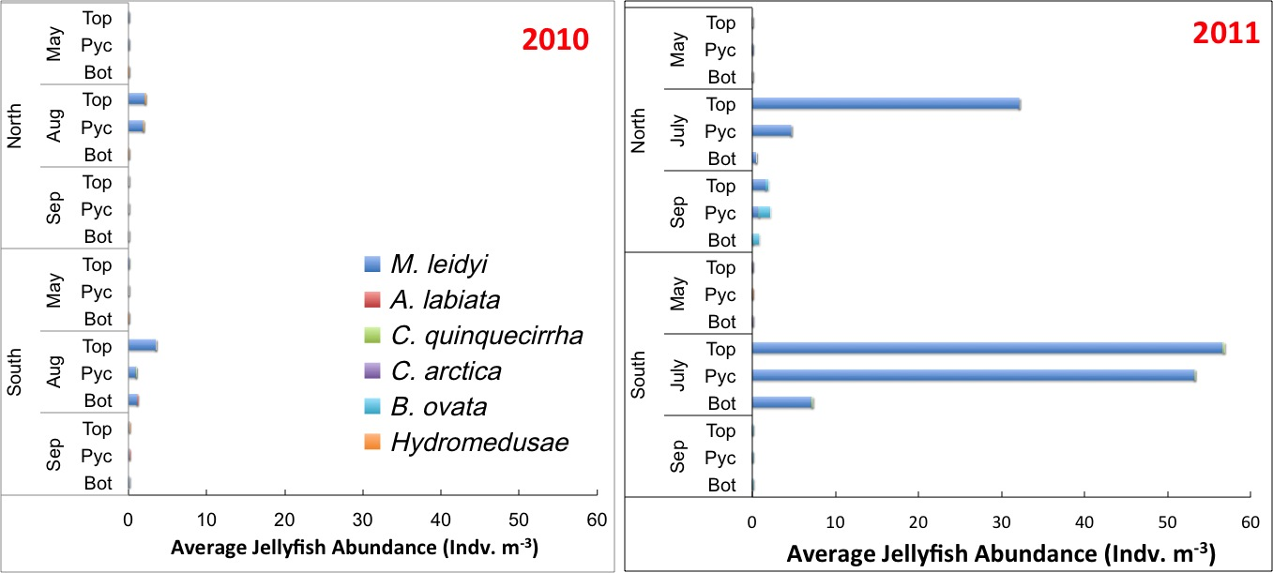
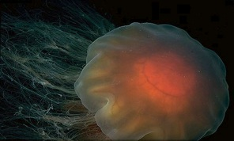
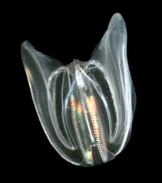
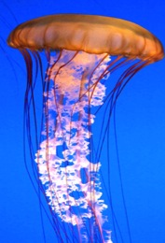
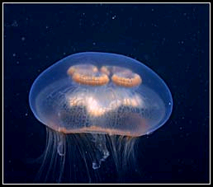
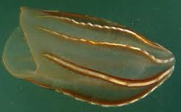
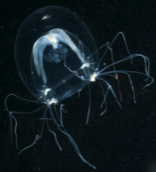
Gelatinous Zooplankton Abundance
Nemopsis bachei
Beroe ovata
Aurelia labiata
Chrysaora quinquecirrha
Mnemiopsis leidyi
Cyanea capillata

Slide 5
Jelly Abundance

Slide 6
Mnemiopsis clearance

Slide 7


Done:
Mnemiopsis abundance & volumes by layer
Chrysaora abundance & volumes by layer
Mnemiopsis population clearance rates
To do:
Convert Mnemiopsis clearance rates to ingestion of A. tonsa per layer (need copepod densities by layer)
Estimate A. tonsa ingestion by Chrysaora
(need copepod densities & temperatures by layer)

